Slide 1

Town of Coventry
Municipal Fire Commission
Fire / EMS Staffing projection
For discussion purposes only

Slide 2

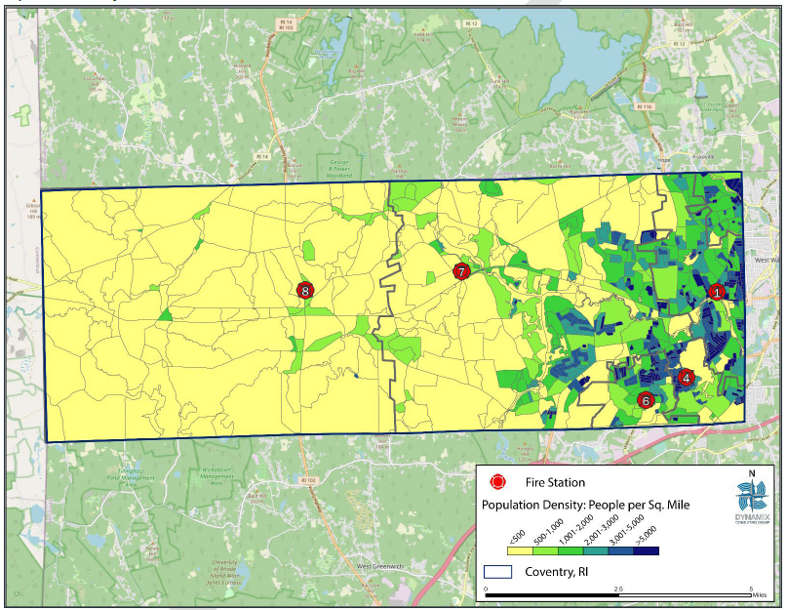
Population density

Slide 3
Population forecast
  Census data shows growth of +0.2% to +0.4% per year for 2000-2020
  Census data not available for 2021+ but can be projected for planning purposes

Slide 4
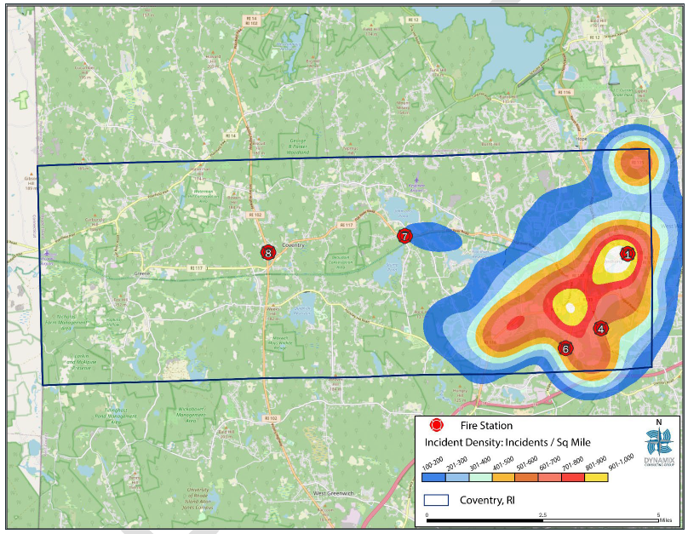
Incident density

Slide 5
Fire / ems call forecast

Slide 6
Current staffing / apparatus in service
  Currently 52 firefighters and 6 apparatus in service across 5 fire stations
  4 out of 5 stations “cross-man” i.e. have multiple apparatus ready to be in service, but only sufficient manpower to use one truck at a time

Slide 7
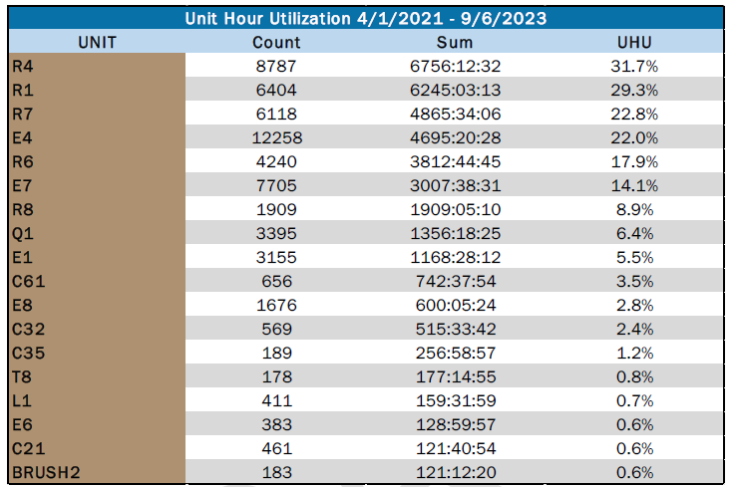
Apparatus over-utilization

Slide 8
Phase 1 service improvement
  Keep 5 stations open in the short term
  Reduce number of full-time Chiefs across all districts from 2 to 1
  Add a full-time dedicated Fire Marshal position to the Town
  Add 4 firefighters to Station 1 to put 7th full-time apparatus into service

Slide 9
Phase 2 service improvement
  Add 8 firefighters to Station 7 (or Station 6) to put 8th full-time apparatus into service
    Discuss longer term need for 5 stations, possibly reallocate staff and downsize to 4 stations
  5 Rescues and 3 Engines in service simultaneously will provide the residents of Coventry a better level of service by reducing missed calls; It will also better spread the workload across both the apparatus and employee base, meaning trucks last longer before replacement and employee OJI risk decreases

