Slide 1

June 9, 2015
FY 2015/2016
Coventry School Committee’s
Recommended Budget

Slide 3
Vision for the Future
Increase Graduation Rate
Increase Student Performance on State Assessments - PARCC
Increase Student Performance on SAT
Increase Attendance Rate
Increase Percentage of Students Attending College
Prepare Students for the Global Digital World

Slide 4
BUDGET SUMMARY
 | Program/Initiative | Potential Expenditure
 | Town taxes in budget with no increase in town funds | $42,655,728
 | Increases requested by School Committee
 | Statewide Transportation for EWG Career & Tech Students (6 Students - $18,000 = $108,000) | $16,000
 | AFJROTC/NDCC | $250,000
 | RtI Administrator | $115,000
 | Administrator Raises (Average of 2%) | $53,000
 | SRP Pension costs | $250,000
 | Achieve Licenses | $23,000
 | High School Athletics (Lacrosse & Girls’ Hockey) | $15,000
 | Total increases | $722,000
 | Town taxes in Original Budget Submission | $43,377,728

Slide 5
BUDGET SUMMARY
 | Program/Initiative | Potential Expenditure
 | Town taxes in Original Budget Submission | $43,377,728
 | Subsequent adjustments
 | Reduction in state aid | $150,000
 | Insurance increases | $40,000
 | 1.0 FTE Elementary Teacher | $80,000
 | Annex Insurance adjustment | ($16,000)
 | SRP pension removal | ($250,000)
 | Total increase in town taxes requested | $726,000*
 | *Not yet approved by School Committee

Slide 6
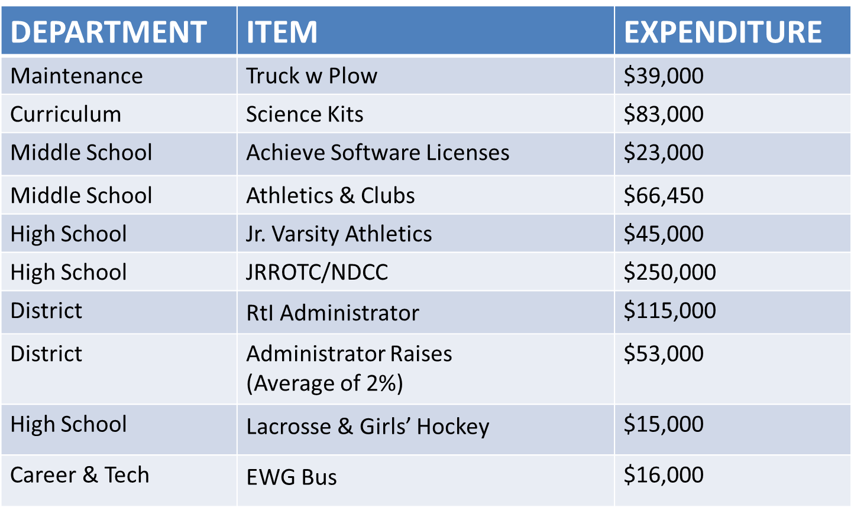
BUDGET INCLUDES

Slide 7
ABSENT FROM BUDGET
Program/Initiative | Potential Expenditure
Full Day Kindergarten | Approximately $1.4 million
Pre-School Reconfiguration | $255,000

Slide 8
School Committee Request
Town Allocation
Revenue Increase Requested
$646,000
Town Council Approved
$0

Slide 9
Impact of 0% Increase from Town
Program/Service/Staff | Cost
Requested Increase for Programs & Services | $646,000
1.0 FTE Elementary Teacher | $80,000
Special Education Services | $TBD
Superintendent Search/Replacement | $TBD
Total Reduction / Cuts | $726,000 +

Slide 10
Potential Program/Services Reduction
Total: $689,450

Slide 11
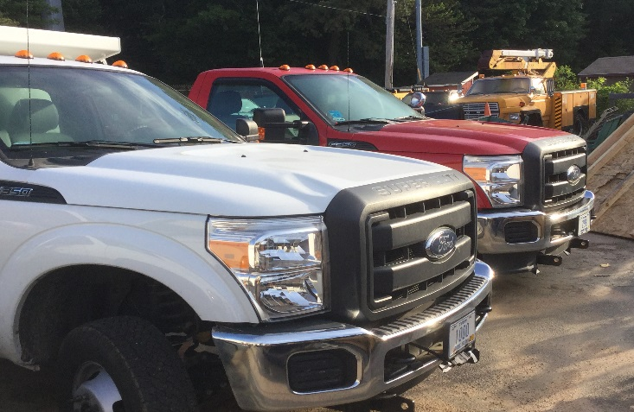
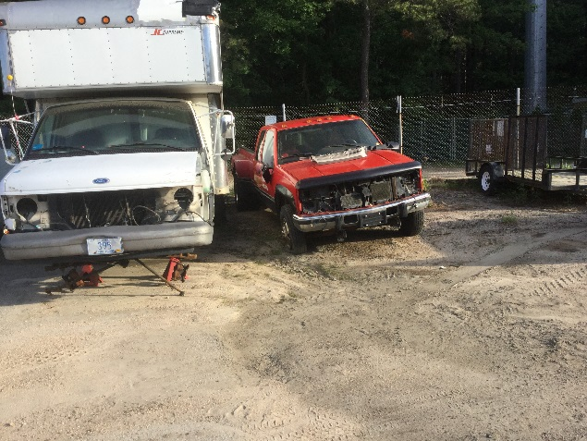
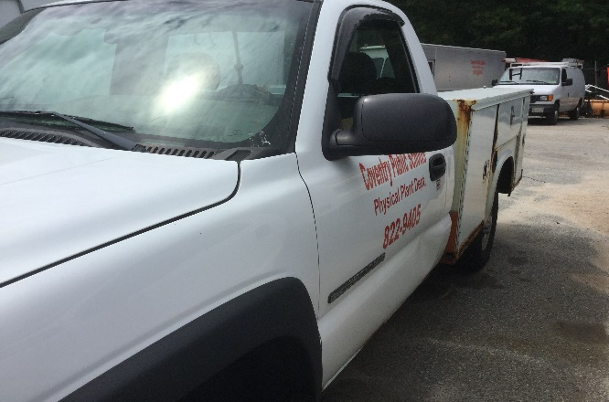
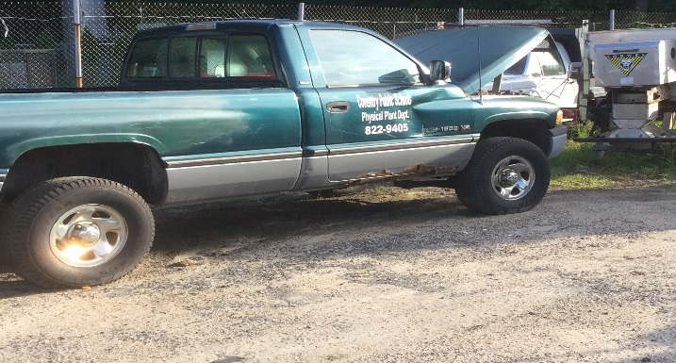
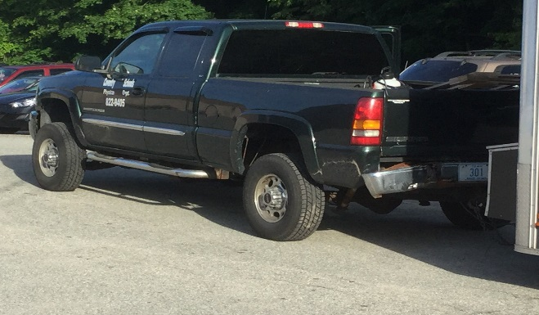
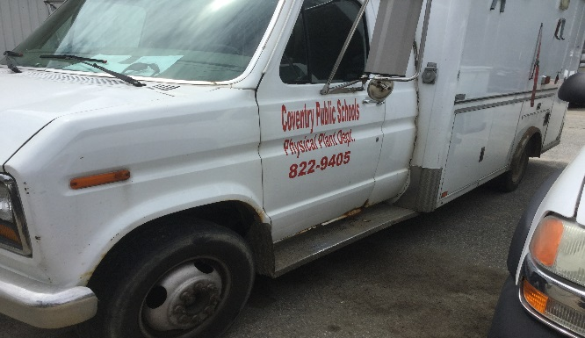
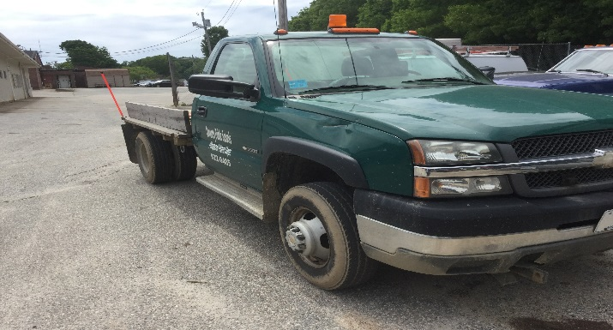

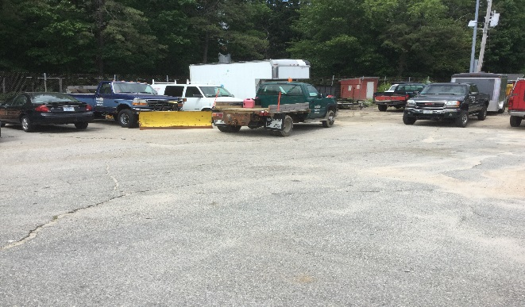
Coventry Public Schools
Maintenance Fleet

Slide 12
Local Tax Allocation History
Year | Town Budget* | % Increase | School Department Budget | % Increase
FY 09 | $17,544,927 | - | $41,580,728 | -
FY 10 | $18,132,704 | 3% | $41,580,728 | 0%
FY 11 | $18,627,374 | 3% | $41,580,728 | 0%
FY 12 | $20,803,863 | 12% | $41,580,728 | 0%
FY 13 | $21,316,693 | 2% | $41,580,728 | 0%
FY 14 | $22,836,259 | 7% | $42,480,728 | 2%
FY 15 | $24,787,927 | 9% | $42,480,728 | 0%
FY 16 | $28,382,255 | 15% | $42,480,728 | 0%
TOTAL Increase | $10,837,328 | 62% | $900,000 | 2%
*Based on Town Audit and Town Financial Meeting Resolution.

Slide 13
The school districts below spend more per pupil than Coventry…
Block Island, Little Compton, Jamestown, Exeter West Greenwich, Newport, Narragansett, Westerly, South Kingstown, Warwick, Central Falls, Johnston, Lincoln, Chariho, Providence, Foster-Glocester, Tiverton, West Warwick, Middletown, Bristol-Warren, North Providence, North Kingstown, Smithfield, Portsmouth, East Greenwich, Scituate, Barrington & Cranston
28

Slide 14
ONLY the following school districts spend less per pupil than Coventry…
East Providence, North Smithfield, Burriville, Pawtucket, Woonsocket & Cumberland
6

Slide 15
If Coventry we just allocated the state average per pupil
(additional $1,494)…
Additional
$7,470,000 PER YEAR

Slide 16
Final Thoughts
How can Coventry continue/implement programs and services for students…or at least maintain?
Will Coventry be the only community in RI without Full Day Kindergarten?
How will teachers be trained on the new standards and assessment programs?
What other programs/services will Coventry need to reduce?
How will Coventry provide equitable opportunities and resources to students similar to the rest of the State?
Does the community value education? Is mediocrity (at best) okay?
How will the community at large be impacted by failing schools and limited resources/opportunities for students?
Why would a young family want to move to Coventry?

