Slide 1
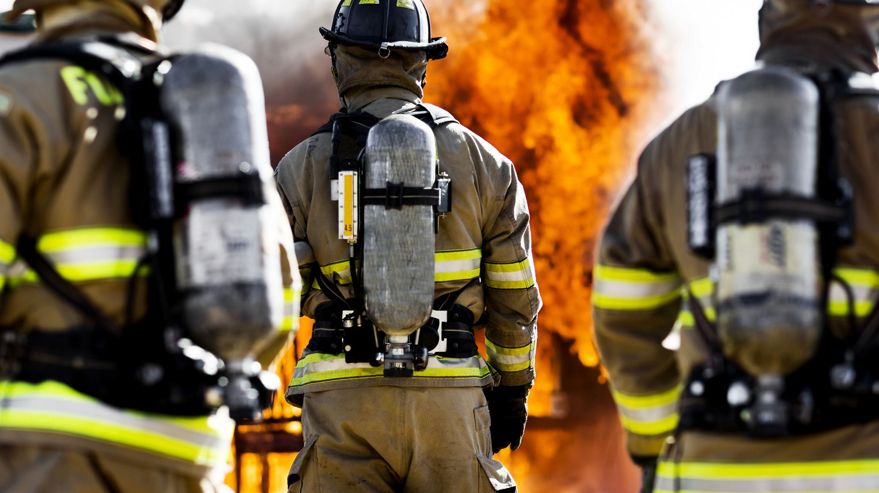
Coventry Municipal Fire Commission: Municipal Department Analysis and Recommendation
Key Findings for the Town Council

Slide 2

Purpose of the Municipal Fire Commission
Commission Establishment and Purpose
Created in 2024 to evaluate and improve fire and emergency services for Coventry's growing community.
Focus Areas
Focused on public safety, financial sustainability, governance, and operational efficiency of fire services.
Collaborative and Data-Driven Approach
Inclusive collaboration with stakeholders and data-based analysis to inform policy decisions transparently.
Implementation and Policy Guidance
Developed comprehensive frameworks to guide the Town Council in making informed fire service decisions.

Slide 3
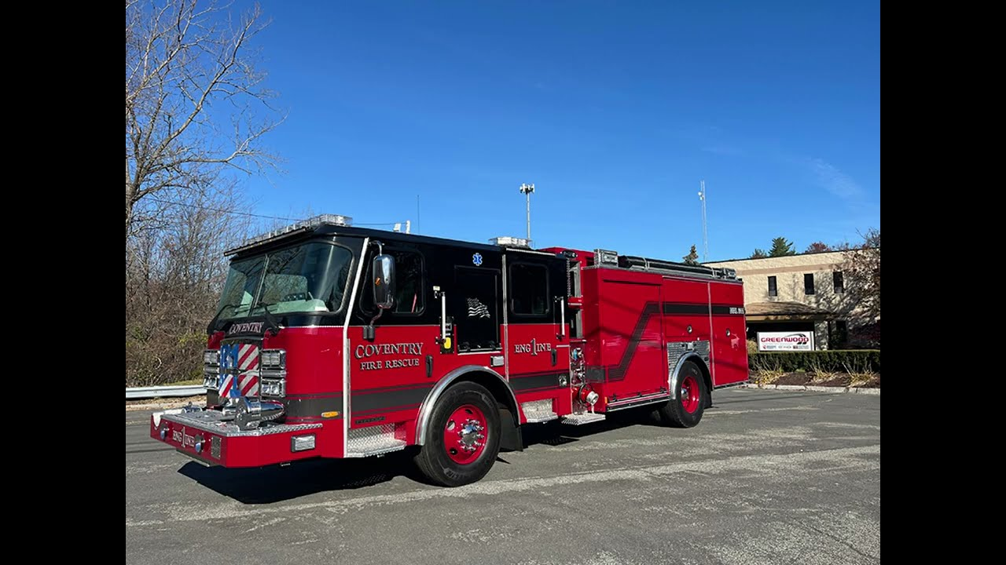
Why Coventry Evaluated Its Fire Service Structure
Fragmented Fire Districts
Coventry’s fire service structure includes four independent districts with separate governance and finances causing operational challenges.
Financial and Operational Instability
Budget rejections and financial instability led to missed pay and reduced apparatus availability, impacting public safety.
Need for Modernization
Growing community demands and geographic size require a coordinated, resilient fire and EMS delivery model for efficiency.
Municipal Model Benefits
Unified budgeting and centralized oversight aim to stabilize finances, improve response times, and provide equitable service.

Slide 4

Why the Fire Service Structure Is a Critical Issue
Operational Challenges
Increasing call volumes, a large geographic service area, and declining staffing create operational strain affecting response reliability and safety.
Uneven Service Levels
The district-based system causes inconsistent response times and coverage gaps.
Governance and Control Gaps
The town lacks direct operational and financial control, complicating long-term planning and proactive issue resolution.
Future Demand and Resilience
Growing community demands require addressing structural issues to support resilient and fair public safety services.

Slide 5

Overview of the Current Fire District Model
Independent Fire Districts
Four separate fire districts run independently, each with its own governance, budget, staffing model, and taxing authority.
Operational Challenges
Independent operation complicates coordination and emergency response, requiring mutual aid and inter-district agreements. The absence of centralized oversight or a unified command structure limits system wide efficiency.
Financial Instability
Recurring financial instability includes budget rejections and reliance on short term measures such as fund balance or emergency loans.
Fragmented Accountability
This decentralized model results in inconsistent policies, uneven service levels, and a lack of performance benchmarks across the town.

Slide 6
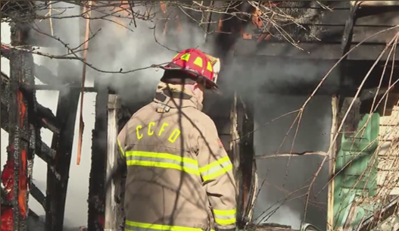
Staffing Trends and Operational Strain
Staffing Pressure vs. Demand
Firefighter staffing levels have declined while emergency call volumes continue to rise, placing increased strain on operations. Ongoing instability has contributed to retention challenges, with personnel leaving for more stable departments.
Impact on Safety and Standards
Fewer firefighters on scene limit the ability to meet established response standards and increase safety risks for both responders and the public.
Organizational Consequences
Chronic understaffing leads to increased burnout, difficulty keeping personnel, and limited capacity to support specialized skills.
Municipal Staffing Solution
A unified municipal structure would allow for pooled personnel, consistent staffing, and improved workforce stability. This strengthens operations and enhances the ability to recruit and keep talent.
Notes:
One of the most significant operational challenges identified by the Commission is the decline in available staffing relative to service demand. Over time, the number of full‑time firefighters has decreased while emergency call volumes have increased. This imbalance places strain on on‑duty crews, increases overtime reliance, and reduces flexibility when multiple incidents occur simultaneously. In practical terms, fewer firefighters on scene can affect the ability to meet nationally recognized response and staffing standards, particularly for structure fires and complex rescues. Staffing shortages also heighten safety risks for responders, who may be required to operate with smaller crews under hazardous conditions. From an organizational perspective, chronic understaffing can contribute to burnout, retention challenges, and difficulty maintaining specialized skills. The Commission’s findings suggest that staffing issues are not isolated to a single district but reflect a broader structural challenge inherent in the current model. Addressing these trends requires a system capable of pooling personnel resources, standardizing deployment, and planning staffing levels on a townwide basis rather than within individual districts.

Slide 7
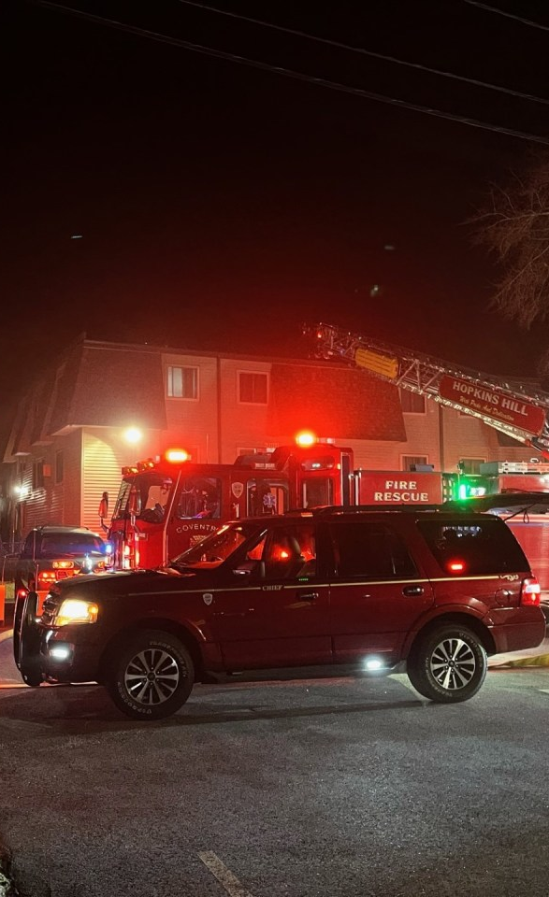
Response Times and Service Consistency
Impact of Response Times
Response time is a critical factor in emergency outcomes, directly affecting survival, fire containment, and rescue effectiveness
Challenges in Resource Availability
Uneven response times are driven by differences in staffing, station coverage, call demand, and fragmented operations across districts
Role of Mutual Aid
Mutual aid is essential for support, but heavy reliance highlights gaps in local capacity & inconsistent service levels
Improving Service Consistency
A more coordinated, centralized approach improves resource deployment, reduces variability, and promotes consistent service standards
service quality should not depend on where you live in Coventry
Notes:
Response time is a critical indicator of fire and EMS performance, directly influencing outcomes for medical emergencies, fires, and rescues. The Commission identified concerns that response times can vary significantly depending on location, staffing availability, and concurrent call volume. In a fragmented system, the closest or most appropriate resources may not always be immediately available under unified command, requiring reliance on mutual aid. While mutual aid is an essential component of regional public safety, routine dependence on it can indicate underlying capacity issues. Inconsistent response capability can undermine public confidence and create perceptions of inequity between different areas of town. Moreover, longer response times can escalate the severity of incidents, increasing property damage and risk to life. The Commission emphasized that improving service consistency is not solely a function of adding resources but also of optimizing deployment, coordination, and governance. A system designed to manage resources centrally has greater potential to reduce variability and ensure that service standards are applied uniformly across the community.

Slide 8
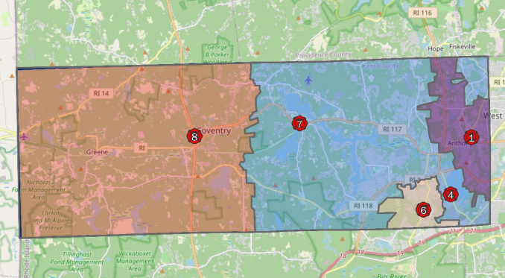
Response Time Goals by Area
Higher Density Areas
The boundary between the Hill Farm Road to West Warwick encapsulates the Eastern end of Town.
The response times for this portion of Town are dependent on how many simultaneous or high impact calls are happening.
Average response times are between 5-8 minutes, faster towards the West Warwick section and slower towards the Hill Farm Road section.
With the reinstatement of Rescue 7 as a continuously manned rescue, longer response times for the Hill Farm Road section would improve dramatically, while also reduce the frequency of Western rescues responding to the Western end of Town, enabling them to respond to calls within their jurisdiction and reduce lapses in service.
Rural Areas
The boundary between Hill Farm Road and the Connecticut border encapsulates the Western end of Town
This area is the most at risk for longer dangerous response times, which can be up to 20 minutes long.
A municipal department will not immediately alleviate this until Rescue 7 is put back in service. With this fully manned rescue, this area would be served by up to two rescues, when there is not another call happening. This improvement would be most beneficial when the apparatus of Station 8 is on a call. Response times for a rescue would drastically decrease from up to 20 minutes to under 10 minutes.
Rescue 7 staffing is less challenging to accomplish in the municipal model as personnel are able to be moved to fill these spots. Hiring one vacancy to fill versus six is much more financially and timely efficient to accomplish.
Commission recommends within the next 5 years to put Engine 8 into service. This would exponentially reduce response times for higher priority labor intensive calls, such as fires, CPR, etc.
Growth and Call Volume
The Town is growing rapidly in population. This growth would be managed initially by the reinstatement of Rescue 7, allowing for two full time staffed rescues in town. This would then be improved with the addition of staff to Station 8, adding a third fully manned rescue to the Town. Developments are currently being added to the more rural sections of Town, which would be better staffed under this model to handle this increase.

Slide 9
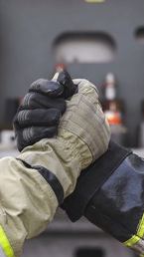
Reliance on Mutual Aid
Role of Mutual Aid
Mutual aid allows departments to support each other during major incidents and periods of high demand, strengthening regional response capacity.
Concerns About Dependence
Frequent reliance on mutual aid indicates gaps in local capacity and places added strain on neighboring departments as they are not available for their taxpayers use.
Impact on Planning and Accountability
Heavy dependence on external support makes it difficult to accurately assess true staffing needs, service costs, and operational performance.
Need for an Integrated Model
A more coordinated, townwide service model would strengthen baseline capacity and improve reliability for both Coventry and its regional partners.
Notes:
Mutual aid agreements are a vital element of fire service operations, enabling communities to support one another during major incidents or periods of high demand. However, the Commission noted that Coventry’s districts rely on mutual aid not only for large scale events but also to meet routine operational needs. This level of dependence raises concerns about baseline capacity within the Town. Frequent mutual aid usage can strain neighboring departments and reduce overall regional resilience, particularly if multiple jurisdictions face simultaneous emergencies. It can also complicate accountability, as response outcomes depend on entities outside the Town’s direct control. From a planning standpoint, heavy reliance on mutual aid makes it more difficult to assess true service costs and staffing needs. The Commission viewed this pattern as a symptom of structural limitations rather than a failure of personnel, reinforcing the need to evaluate whether a more integrated service model could better support both Coventry and its regional partners.

Slide 10
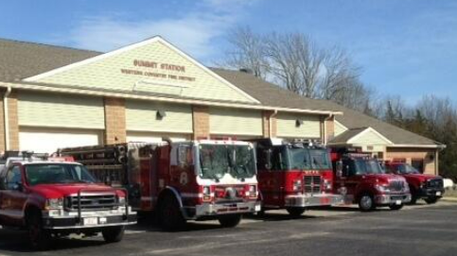
Current District Model Core Issues
In Summary, the outdated district model is no longer sustainable
It drives:
Financial volatility
Staffing instability
Inefficient operations
Unequal and sometimes unsafe service delivery

Slide 11
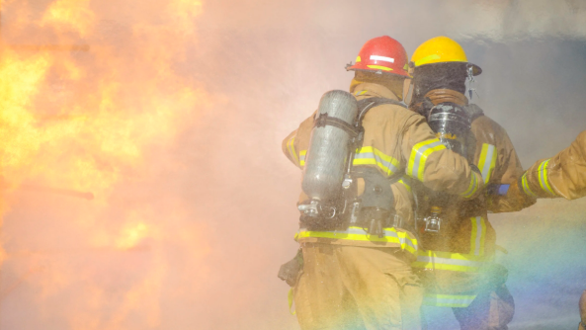
Current District Finances vs Proposed Municipal Budget

Slide 12
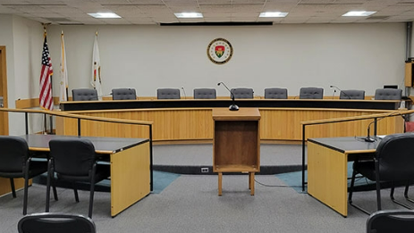
Town Authority and Accountability
Alignment of Authority and Responsibility
Effective governance requires decision making authority to align with responsibility to ensure accountability and prompt action.
Current Limitations
Under the current structure, the Town Council lacks direct control over fire service operations and finances, limiting its ability to manage risk and set policy.
Municipal Department Model
A municipal model centralizes governance, budgeting, and oversight under the Town, creating clearer accountability and more coordinated decision making.
Governance Responsibilities
The Town would assume responsibility for labor agreements, capital planning, and existing liabilities as part of a unified and accountable governance structure.
The Coventry Town Charter specifies that responsibility for fire, EMS, and public safety rests with the Town
Notes:
A central theme in the Commission’s work is the alignment of authority with responsibility. While the Town Council is ultimately accountable for public safety, it currently lacks direct control over fire service operations and finances. This misalignment limits the Town’s ability to set consistent policy, enforce standards, and respond decisively to emerging risks. A municipal department model would place governance, budgeting, and operational oversight under the Town, creating a clearer chain of accountability. Such a shift would also require the Town to assume responsibility for labor agreements, capital planning, and long‑term liabilities.

Slide 13
Tax Structure and Community Impact
Current System: District-Based Taxes
Municipal Model: Unified Tax Structure
Each fire district has its own tax rate
Tax rates continue to rise – fire districts do not have tax increase limits
Residents pay different amounts for similar or less services
Funding is fragmented and inconsistent
Limited coordination across districts
Each district pays for redundant services
Merging creates a single, consistent tax rate
Costs are shared across all residents
Fire taxes are rolled into the protection of the town tax increase limits
Funding is centralized and predictable
Ensures equal service levels for all residents
Creates 1 tax bill – Allows fire taxes to be included in escrow payments
Today’s system distributes costs unevenly — a municipal model distributes them equitably

Slide 14
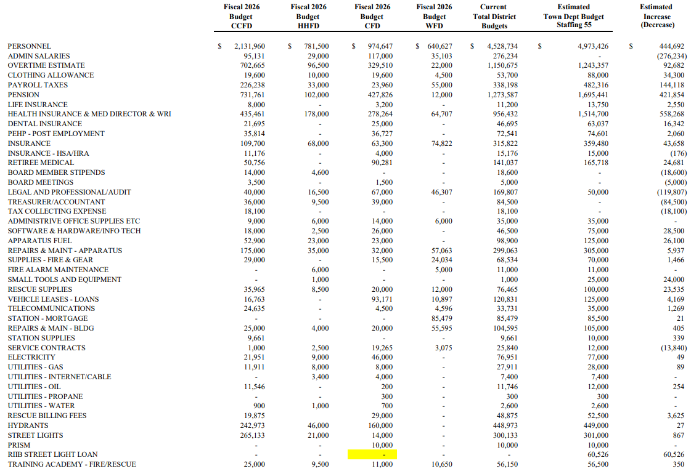

Slide 15
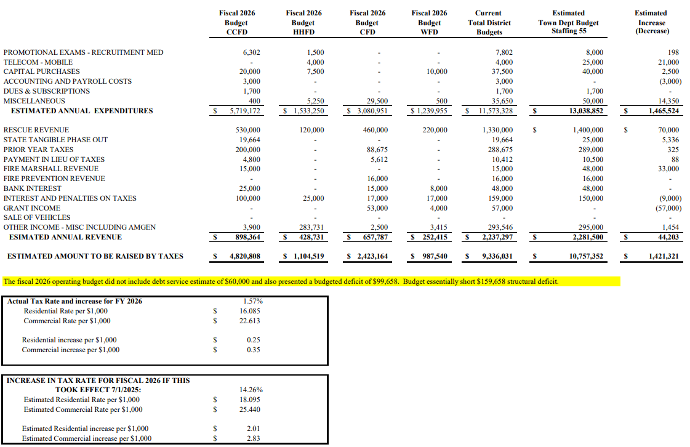

Slide 16
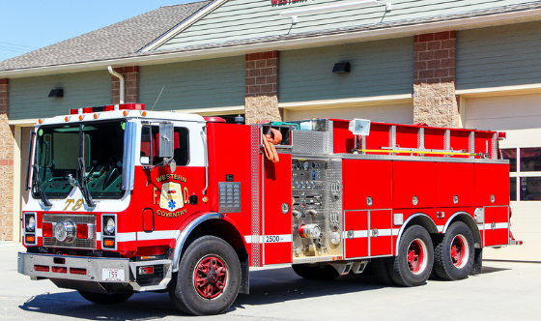
Understanding the Presented Municipal Budget
Transitioning to a municipal model creates a unified funding approach and sets up a consistent tax structure across the Town. Because current tax rates vary by district, moving to a fair, townwide structure will require increases in some districts and decreases in other districts.
Balancing Taxes and Service Quality
Tax Impact Context
Combining municipal and district fire taxes shows tax increases align with historical growth. This would limit higher increases, such as the 13.91% increase that WCFD witnessed this year.
Conservative Budget Assumptions
The presented budget uses high-end assumptions including top pay scales and all employees taking family medical and dental plans to create a worst-case scenario buffer. This budget also does not include any collective bargaining agreement with employees, so it includes the highest levels for clothing allowances, longevity pay, stipends, etc.
Presented budget is the worst-case scenario. Other budgets were also analyzed using current employee medical plan choices, years in service affecting longevity pay, credentials affecting stipends, etc. These analysis yielded a more realistic budget of almost breakeven numbers.
Notes:
The Fire Commission’s draft municipal fire department budget indicates that projected expenses are a little over one million dollars higher than what the four fire districts currently raise in combined revenue. While this figure is frequently cited, the report itself explains that the budget was intentionally constructed using conservative, high-side assumptions. These assumptions include placing all firefighters at the top step of their pay scales, assuming universal enrollment in the most expensive family health insurance plans, and modeling benefit costs at their maximum levels. In practice, municipal budgets rarely reflect such uniform peak costs. As a result, the apparent $1M gap should be understood as a worst-case planning buffer rather than a precise or expected deficit. When normalized compensation assumptions and documented savings are applied, the financial picture shifts significantly toward break-even or modest surplus. This distinction is critical for policymakers, because it reframes the municipal budget from an expansionary cost increase to a restructured and more stable allocation of resources already being paid for by taxpayers.

Slide 17
Taxes Today vs One Unified Rate
(Value based on assessments prior to reevaluation)
$300K Home:​
CURRENT SYSTEM (Uneven Taxes)
​ → Transition to Municipal Model →​
MUNICIPAL MODEL (Balanced Taxes)
​ Today’s tax bill depends on location
Under a municipal model it depends on home value
HHFD: $5,420
CCFD: $5,307
CFD: $5,433
WCFD: $5,333​
Same Tax Amount for all residents
$5,428.50

Slide 18
Tax Impact by District (Analyzed from most conservative budget outlined in prior slides)
Hopkins Hill FD: +$9.00 (0.17%)​
Coventry FD: -$4.50 (-0.08%)​
Central Coventry FD: +$121.50 (2.29%) Largest increase due to lowest current tax rate​
Western Coventry FD: +$95.10 (1.78%)​
Tax Increase is based on a $300,000 house valuation and current tax rates
*Taxes based on the 2026 WCFD fire taxes. These taxes were increased 13.91% voted on April 2026 and actual tax impact would be less than these figures.

Slide 19
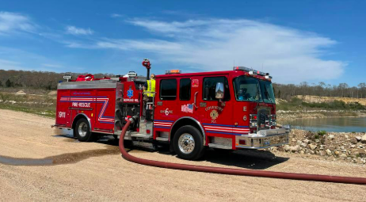
Savings and Other Considerations
Annual cost savings can be compounded, allowing for more hiring potential and a stable financial department than the current district model. These savings are recurring, structural, and independent of service reductions. Importantly, they create fiscal capacity that can be reinvested into staffing, apparatus availability, and response time improvements without increasing the overall tax burden beyond historical norms.
Administrative Cost Savings
Consolidating audit, payroll, legal, and clerical functions could save about $455,000 annually in administrative costs.
Leadership Consolidation Savings
Merging multiple chief positions into a single leadership role can save between $175,000 and $225,000 yearly and allow for more leadership positions within the stations / platoons to create more stability.
Efficiency in Purchasing and Maintenance
Unified contracts for equipment and services have the potential to save. This cost savings would not be known until contracts with venders are negotiated.
Grant Monies
Historically municipal departments have better luck receiving federal grant money as compared to the district model. Access to dedicated grant writ
Current Liquid Assets
One item not discussed in the municipal budget is the district liquid financials. The four districts have a combined total of $3,446,574.36 cash assets at the time this presentation was created. It should be noted that some of these funds are allocated for apparatus purchases that are not yet ready for receival.
Notes:
A central finding of the Commission’s analysis is that the current four-district system carries substantial built-in duplication that produces no corresponding public safety benefit. Each district maintains its own audit services, legal counsel, payroll processing, tax collection, clerical staff, and administrative leadership. The report estimates that consolidating these functions into a single municipal department would save approximately $455,000 annually in administrative costs alone. Additional savings result from leadership consolidation. The current structure supports multiple chief-level positions, including at least one chief whose compensation is significantly lower than a typical full-time municipal chief. When these roles are consolidated into a single chief with a clear chain of command, realistic net savings are estimated in the range of $175,000 to $225,000 per year. Further efficiencies are expected from unified purchasing and maintenance contracts for apparatus, equipment, facilities, and services. Exact savings require competitive rebidding. These savings are recurring, structural, and independent of service reductions. Importantly, they create fiscal capacity that can be reinvested into staffing, apparatus availability, and response time improvements without increasing the overall tax burden beyond historical norms.

Slide 20
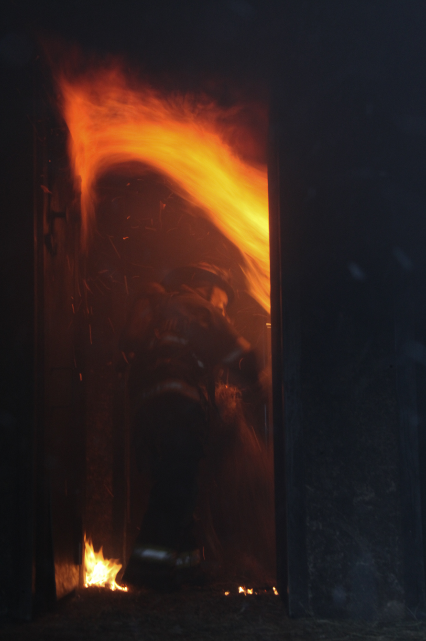
Recommendations and Final Thoughts

Slide 21
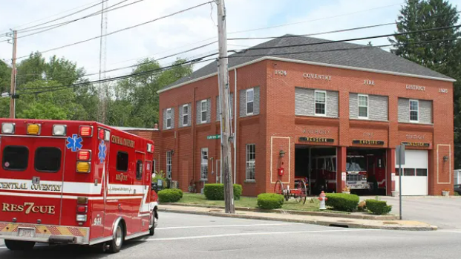
Impact of Adding 1 Firefighter
Cost of Adding One Firefighter
Adding one firefighter costs approximately $153,000 annually including salary, medical benefits, retirement costs, etc.
Operational Impact
As stated before, adding one firefighter improves coverage by being able to reinstate Rescue 7 to the Central/Western portion of Town.
Municipal Budget Flexibility
The budget can absorb modest staffing increases without raising taxes, as the presence of a full-time staffed rescue allows for the increase in rescue recovery funds without the need for mutual aid rescues from out of town.

Slide 22
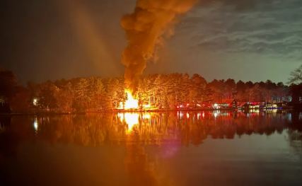
Other Questions to Consider:
How is existing district debt being incorporated into the proposed municipal model?
Assumed into the budget lines. Under a municipal model it can be restructured with a better rate or paid off using district funds.
How can a reliable operating budget be projected without a defined labor contract? What assumptions are being used for wages, benefits, staffing levels, and work rules?
A defined labor contract was not a part of the municipal fire commission’s scope as this is a legal process that should only be done when a municipal fire department is created by the Town. To offset this, the highest benefit of each district contract was incorporated into the budget. Realistically this budget is very conservative but in lieu of negotiating a contract, the Commission wanted to give a worst-case scenario number.
Does the proposal assume cross-manning of apparatus? What is the projected cost impact of adding additional personnel?
The budget proposed includes staffing apparatus as they are currently. The exception to this is the instances where there are more than two personnel. The recommendation would be to move those seven personnel to Rescue 7 and hire one more to fully staff that apparatus. After this, hiring eight personnel would allow for two apparatus to be manned at Station 8. The goal would be to eventually not cross man and staff each apparatus. This could lead to reduced overhead with consolidated stations, less total apparatus costs as the current model incorporates many vehicle duplicates that are not fully manned, etc.
What is the final “fully built-out” cost of the municipal department? Does this include worst-case scenarios where operational flexibility (like cross-manning) is limited?
The worst-case scenario of the fully built-out cost of the municipal fire department is outlined above in the financial slides. This accounts for the highest cost line items of each district contract, the current staffing model, the most expensive benefit plans, etc. As outlined in the previous question, eliminating cross-manning of apparatus could find cost savings in building consolidation and reduction of total apparatus needed.
What are the projected costs for immediate facility repairs, apparatus replacement or upgrades in the near term? Are these costs included in the municipal projections, or treated separately?
No immediate facility repairs or apparatus replacements were noted by the four districts. As such, they are not included in the municipal projections. However, each district has funds allocated towards building maintenance and apparatus funds that were carried over into the municipal budget.

Slide 23
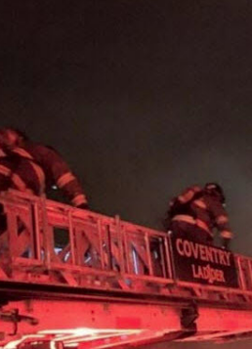
Municipal Dept. Timeline
Improved Immediately
Remove all Brown Outs of Rescue 8 due to staffing
Provide 24/7/365 of ALS and dual EMS/Fire coverage of Station 8
Single command structure to limit confusion on a fire scene
Unified training
Within the First Year
Hire 1 for Rescue 7
Negotiate contracts & consolidate obligations (financial, legal, etc.)
All nonunion personnel entered into the MERS program (WCFD and any new personnel)
Within the First Five Years
Hire 8 for Engine/Tanker at Station 8
After the First Five Years
Consolidate into four stations while not decreasing staffing/ apparatus. This will reduce the operational budget burden on the department and condense redundancies.
Hire 8 for Engine / Ladder at Station 1
Reduce/eliminate the need for cross manning to allow for the fulltime manning of all Town rescue apparatus and potential consolidation of apparatus and close proximity stations

Slide 24
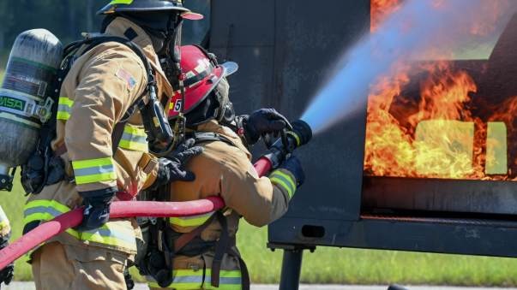
How a Municipal Model can Fix Current Issues
Operationally
Stabilizing staffing, restoring critical apparatus, and improving response times while reducing mutual aid dependency.
This can be seen by:
Staffing shortages: Less turnover as staff no longer are using the districts as a steppingstone to a bigger municipal system. Less turmoil as historically seen under a central municipal leadership structure.
Size of town: Coventry is unique in its size and length. Currently, the Western end is not staffed when on a call or is not reliably staffed with ALS or two personnel 24/7/365, which leads to more apparatus needed from other districts or towns. A municipal model can fix this by allowing for staffing flexibility, equal area staffing qualifications, and a smaller financial burden for the addition of a full-time rescue. This will reduce the amount of mutual aid burden on neighboring departments and shorten response times.
Firefighter safety: Firefighter safety is upmost importance. In the current district model, there have been instances of injuries, close calls, and insufficient staffing for large scale incidents. Mentally, the reality of burnout due to improper staffing models is very real. A municipal mode eases this with dedicated apparatus staffing, equal personnel qualifications, and centralized training to ensure all members are up to date and trust their coworkers in very stressful and dangerous situations.
Staffing model tied to call volume: Call volume keeps increasing as Coventry grows. The fire department needs to grow to meet these increased needs. The municipal model will allow for better appropriation of staff, reliable ALS rescue services, and dedicated apparatus staffing through financial stability and savings and a centralized operations and management.
Notes:
The Fire Commission’s analysis makes clear that the municipal fire department model offers Coventry substantial advantages over the existing four-district system. Financially, it eliminates redundant administration, improves oversight, and converts inefficiency into recurring savings that can be reinvested into public safety. Operationally, it stabilizes staffing, restores critical apparatus, improves response times, and reduces dependence on fragile mutual aid arrangements. From a governance standpoint, it places accountability squarely with elected Town leadership, ensuring transparency, consistent budgeting, and professional management. Importantly, the municipal model also promotes equity: every resident receives the same level of fire and EMS service at the same tax rate, regardless of historical district boundaries. The alternative—maintaining the status quo—perpetuates instability, uneven service, and growing risk, particularly as Coventry continues to grow and age. Abolishing the four fire districts is not about diminishing local identity; it is about modernizing essential services to meet current and future needs. Based on the findings, the municipal fire department is financially viable, operationally superior, and strategically necessary to protect the safety and fiscal health of the Town of Coventry.

Slide 25
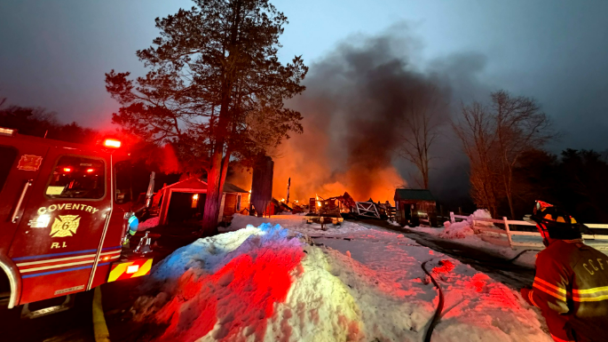
How a Municipal Model can Fix Current Issues (cont.)
Financially
The municipal model reduces redundant administration salaries and processes and creates recurring savings to reinvest in public safety.
Governance and Accountability
Accountability is centralized with elected town leadership, ensuring transparency and professional management.
Ownership of the municipal model would fall within the entity who is essentially responsible for it and potential legal action.
Equity for Residents
Every resident receives equal fire and EMS services at the same tax rate regardless of district boundaries.
shortages, size of town, growing call volume, reliance on mutual aid, response times, firefighter safety)

Slide 26
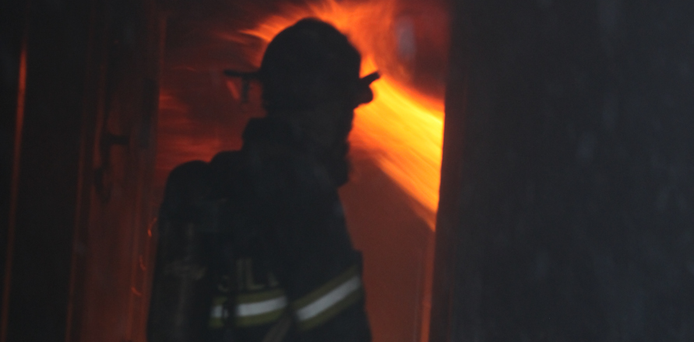
Thank You Questions?

