Slide 1

COVENTRY FIRE DEPARTMENT
DISTRICT & MUNICIPAL SNAPSHOT
The budget is calculated at the highest level to provide a “worst case scenario”
  Assumes all employees take a family plan for medical and dental
  Assumes highest steps for salary calculations
A municipal model will create a centralized command structure, increasing department efficiency and personnel collaboration
A municipal model eliminates approximately $600,000 of duplicative services
A municipal model would ensure an equal level of care across the town on a consistent basis
Due to the collective bargaining agreement, apparatus must remain staffed without any scheduling holes due to lack of personnel
Largest single cost increase is due to adding 6 FTEs from Western Coventry Fire District to the Municipal Employee Retirement System (MERS)
A municipal model would allow residents to pay all taxes under one bill that can be escrowed into a mortgage account
A municipal model allows for maximum flexibility for town coverage
A municipal model eliminates taxpayer responsibility of rescue bills after insurance billing “balance billing” for ambulance services in Western Coventry
Since this analysis, three districts have increased their budgets. This document reflects this except for the tax rate information, which will be dependent on when the new Coventry Fire District budget is passed
A single municipal department is projected to have higher retainage than the district model due to increased stability and career growth opportunities
A municipal model would restrict total property tax levy increases to the Town’s 4% maximum based on the prior year. Fire Districts typically do not have a legal maximum increase, and some have historically raised taxes by double digits
Additional Information
Website: coventryri.gov/municipal-fire-commission
Full Annual Budget Estimate
Municipal Fire Commission Final Report

Slide 2
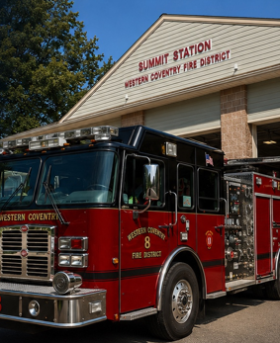
WESTERN COVENTRY FIRE DISTRICT
At a Glance
STAFFING
4 Full Time ALS EMT/FF
2 Full Time BLS EMT/FF
Supplemental Per Diem Staffing
SCHEDULE
Schedule dependent staffing.
Typically, 2 on duty personnel cross manning two primary apparatus.
Callbacks for large events and storms
SERVICE AREA
3,700 residents served over 31 square miles
STATIONS
Station 8 (Summit Station)
1110 Victory Highway
Greene Station (Unmanned Storage)
2 Hopkins Hollow Road
APPARATUS
• Engine 8
• Rescue 8
• Tanker 8
• Engine/Tanker 9
FINANCIAL SNAPSHOT (FY ‘26/27)
Budget: $1,399,469
Total Fund Balance*: $513,686
*As of April 2026 Annual Meeting
Total Loan Liabilities: $1,099,960
Station 8 mortgage $768,764
Rescue 8 loan $177,236
Engine/Tanker 9 loan $153,960
Did You Know?
100% of the current full time members began their careers as per diem members.
FIRE TAX INFORMATION
Current Tax Rate: 1.693 /$1000 (FY 2025/2026)
Upcoming Tax Rate: 1.93 /$1000 (Based on Prior Evaluations)
Proposed Municipal Tax Rate of current fire taxes**:
+1.78%
**Based on the FY 2025/2026 Financials. Budget was increased by 13.91% FY 2026/2027
• Chief SUV
• Unit 8
• Brush 1
• Kubota
WCFD Website: Wcfd.net

Slide 3
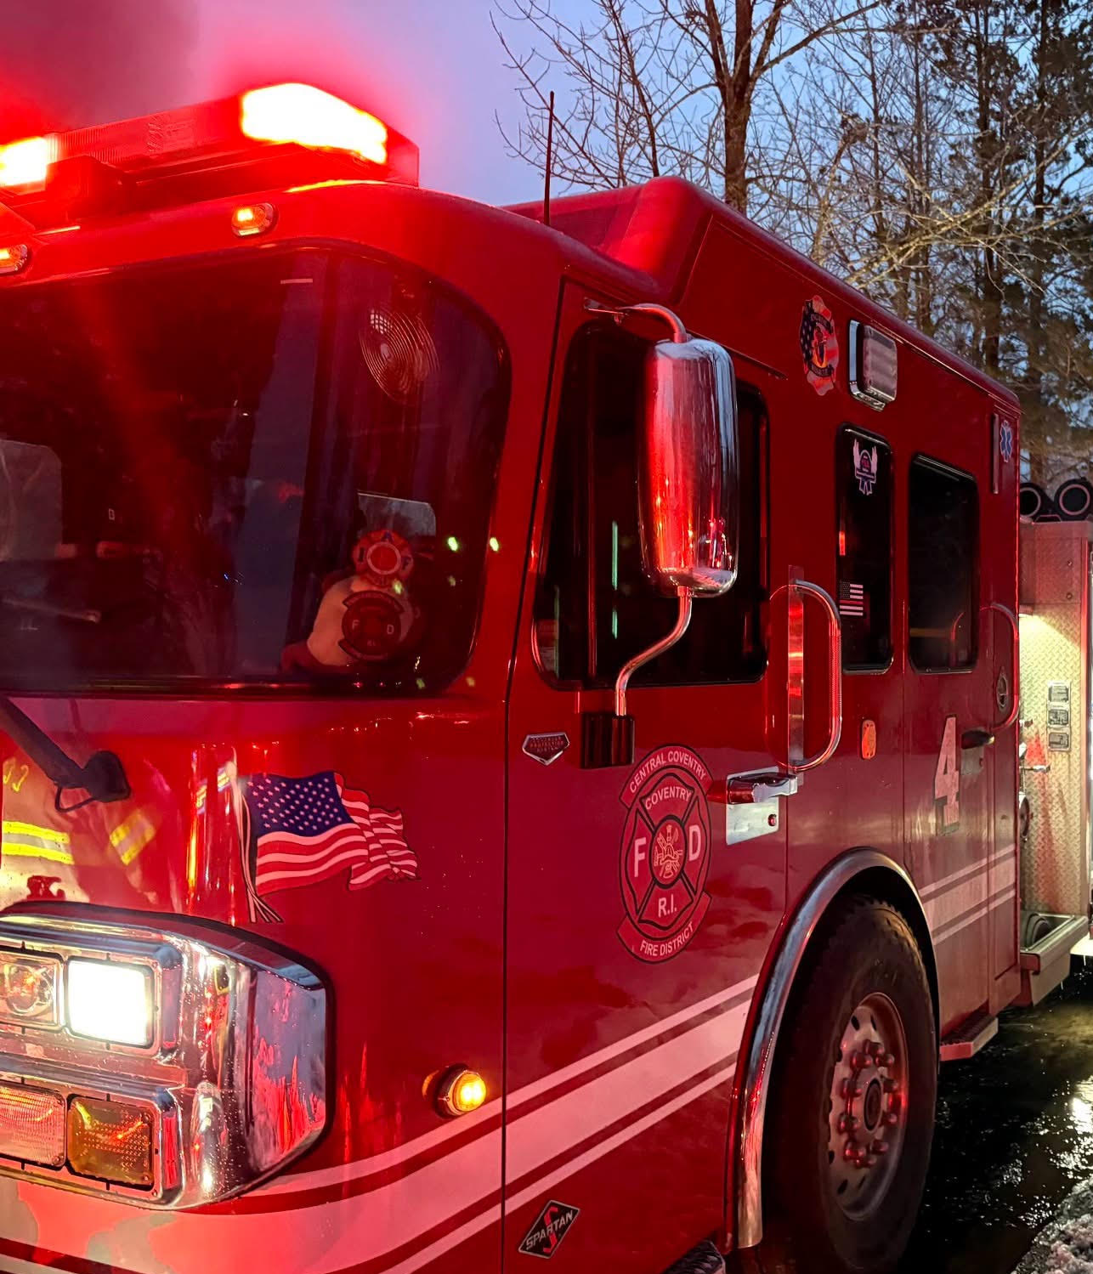
CENTRAL
COVENTRY FIRE DISTRICT
At a Glance
STAFFING
28 Full Time ALS EMT/FF
SCHEDULE
Staffed 24/7/365
2–3 on duty personnel per three primary apparatus.
Call backs for large events and storms
SERVICE AREA
20,000 residents served over 26 square miles
STATIONS
Station 4
240 Arnold Road
Station 7
2847 Flat River Road
APPARATUS
• Engine 4
• Engine 7
• Rescue 4
• Marine 7
• Chief SUV
FINANCIAL SNAPSHOT (FY ‘26/27)
Budget: $5,025,608
Total Fund Balance: $1,832,402
Total Loan Liabilities: $159,000
LED Streetlights $143,000
Chief Vehicle $16,000
Pension Funded Ratio: 71.5%
Did You Know?
Members have volunteered their time for over twenty years for the tradition of escorting Santa.
FIRE TAX INFORMATION (FY ‘25/26)
Current Residential Tax Rate: 1.605 /$1000
Proposed Municipal Tax Impact of current fire taxes:
+2.29%
• Fire Marshal SUV
• Reserve Engine 5
• Reserve Rescue 7
• Inflatable Boat 4
• Inflatable Boat 7
CCFD Website: ccfdri.com

Slide 4
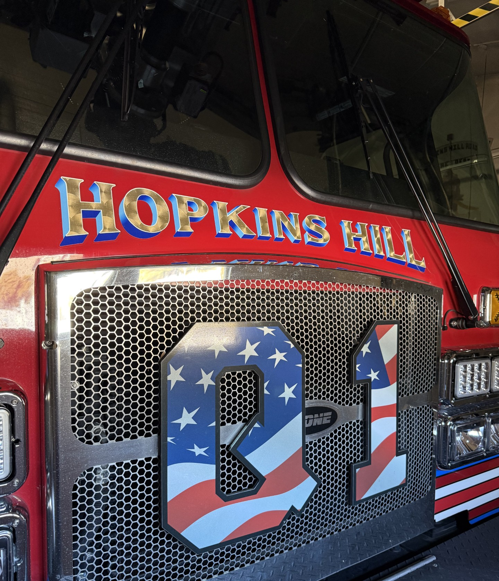
Hopkins Hill
FIRE DISTRICT
At a Glance
STAFFING
9 Full Time ALS EMT/FF
SCHEDULE
Staffed 24/7/365
2 on duty personnel cross manning three primary apparatus.
Call backs for large events and storms
SERVICE AREA
6,000 residents served over 2.5 square miles
STATIONS
Station 6
1 Bestwick Trail
APPARATUS
• Quint 1
• Engine 6
• Rescue 6
• Chief SUV
• Fire Marshal SUV
• Utility 1
• Decon Trailer
• Brush 2
• UTV 1
• Inflatable Boat
FINANCIAL SNAPSHOT (FY ‘26/27)
Budget: $1,653,850
Total Fund Balance: $584,970
Total Loan Liabilities: $607,447
New Rescue $307,015
Quint 1 $300,432
Pension Funded Ratio: 103.8%
Did You Know?
The first fire engines in the Hopkins Hill area were converted farm equipment in 1952.
FIRE TAX INFORMATION (FY ‘25/26)
Current Residential Tax Rate: 1.98 /$1000
Proposed Municipal Tax Impact of current fire taxes:
+0.17%
HHFD Website: hopkinshillfiredistrict.com

Slide 5
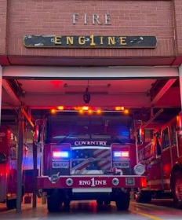
COVENTRY FIRE DISTRICT
At a Glance
STAFFING
12 Full Time ALS EMT/FF
SCHEDULE
Staffed 24/7/365
2–3 on duty personnel cross manning two primary apparatus.
Call backs for large events and storms
SERVICE AREA
10,000 residents served over 5.5 square miles
STATIONS
Station 1
571 Washington Street
APPARATUS
• Ladder 1
• Engine 1
• Rescue 1
• Reserve Rescue 1
• Chief SUV
• Fire Marshal SUV
• Inflatable Boat
FINANCIAL SNAPSHOT (FY ‘25/26)
Budget: $2,981,293
Total Fund Balance: $771,865
Total Loan Liabilities: $492,578
Engine 1 Loan $492,578
Pension Funded Ratio: 58.2%
Did You Know?
The Coventry Fire District is the oldest in Coventry, established in 1889.
FIRE TAX INFORMATION (FY ‘25/26)
Current Residential Tax Rate: 2.025 /$1000
Proposed Municipal Tax Impact of current fire taxes:
-0.08
CFD Website: coventryfdri.gov

Slide 6
COVENTRY
MUNICIPAL FIRE DEPARTMENT
At a Glance
STAFFING
55 members
Opportunities for growth in the most vulnerable areas of Town due to more grant opportunities for a municipal department.
SCHEDULE
24/7/365
ALS/FF Level
No uneven service levels
No schedule gaps
SERVICE AREA
All of Coventry served by one department, enabling resources to be shifted between all stations as required by taxpayer needs.
For Example, shifting the current 3 personnel to 2 on an apparatus to allow for Rescue 7 to be brought into service.
STATIONS & APPARATUS UNITED FROM DISTRICTS
No more Balance Billing
FINANCIAL SNAPSHOT (As of 09/2026)
Budget: $13,038,852
Total Fund Balance: $3,702,923
Total Loan Liabilities from Districts: $ 2,542,945
Current District Pension Obligations
Addition of WCFD personnel to MERS
TAX INFORMATION (FY ‘25/26)
Fire taxes are combined into Town tax bill (one bill now)
All taxes are even, based off home value not location
Actual Tax Rate Increase for FY 2026: +1.57%*
Causes a 14.26%* tax increase on paper due to the already paid fire taxes being absorbed into the Town taxes
Website: coventryri.gov/municipal-fire-commission

